Slide 1
Credit card fraud Analytics
Submitted in the partial fulfillment for the award of the degree of
BACHELOR OF ENGINEERING
IN
CSE – INFORMATION SECURITY
Submitted by:
21BCS3692 – Chinnari. Abhishek
Under the Supervision of:
Ms. Sidrah Fayaz Wani (E17441)
Department of AIT-CSE
DISCOVER . LEARN . EMPOWER

Slide 2
Outline
Introduction to Project
Problem Formulation
Objectives of the work
Methodology used
Proposed System
Result & Output
Conclusion
Future Scope
References

Slide 3
Introduction to Project
Fraud detection is the process of identifying and preventing fraudulent credit card transactions.
Credit card fraud can cost businesses and consumers billions of dollars each year.
Fraud detection systems use a variety of factors to identify suspicious transactions, such as purchase amounts, locations, and device information.
Fraudsters are constantly developing new techniques to evade detection, so fraud detection systems must be constantly updated.
By detecting and preventing fraudulent transactions, businesses can protect their customers and their bottom line.

Slide 4
Problem Formulation
The problem formulation for credit card fraud detection involves identifying fraudulent credit card transactions in real-time to prevent financial losses for both the card issuer and the cardholder.
The Credit card transactions are numerous, and fraudulent transactions can be difficult to distinguish from legitimate transactions.
Fraudulent activity is constantly changing, and fraudsters are always finding new ways to circumvent detection systems.
Fraudulent transactions need to be detected in real-time to prevent further fraudulent activity and minimize financial losses.

Slide 5
Objectives
The research objective for credit card fraud detection is to develop an efficient and accurate system that can detect fraudulent transactions in real-time.
The system should aim to achieve the following goals:
Increase the accuracy of fraud detection.
Improve the speed of fraud detection.
Enhance the customer experience.
Ensure compliance with regulations.
Adapt to evolving fraud patterns.

Slide 6
Methodology Used
The methodology for credit card fraud detection involves the following steps:
Data Collection
Data Preprocessing
Feature Engineering
Model Selection and Training
Model Evaluation
Model Deployment

Slide 7
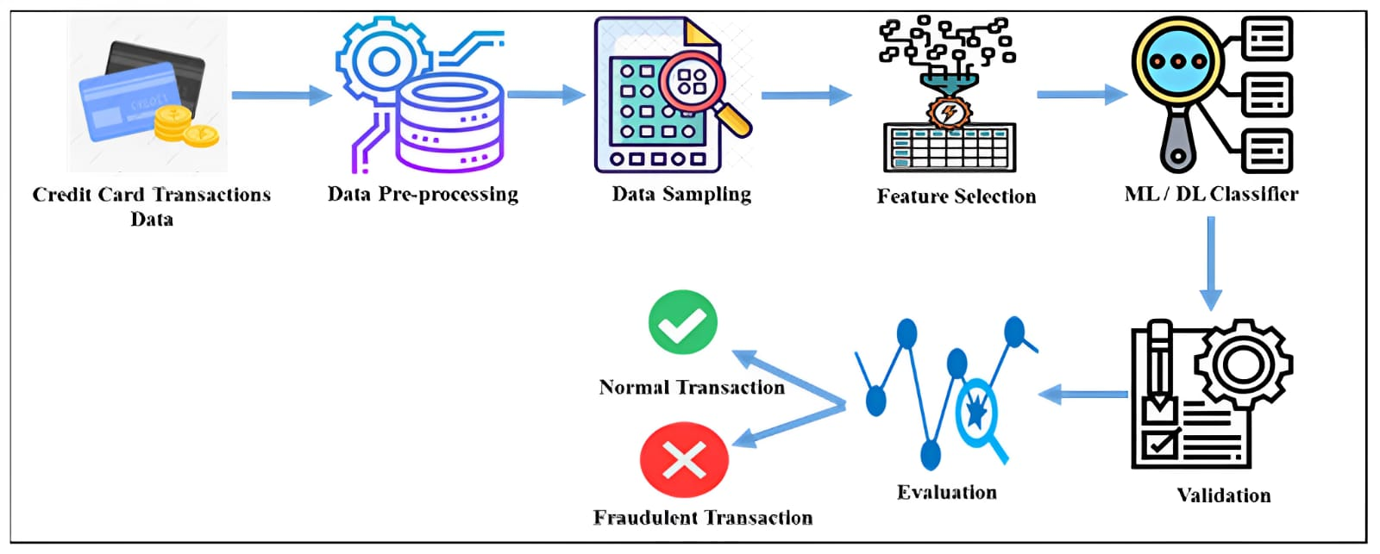
Methodology Used:

Slide 8

Proposed System
We are used three algorithem’s to check accuracy and F1 scores.
Those are
Logistic Regression
SVM(Support Vector Machine)
Random forest
Logistic Regression:
A statistical model that predicts the probability of a binary outcome (e.g., yes/no, pass/fail) based on a set of predictor variables.
Uses a logistic function to transform the output of the model into a probability value.
Can be used for a variety of tasks, such as fraud detection, spam filtering, and medical diagnosis.

Slide 9
Proposed System
SVM(Support Vector Machine) :
A supervised machine learning algorithm that can be used for classification or regression tasks.
It works by finding a hyperplane in the data that separates the different classes or groups of data points.
The hyperplane is chosen such that the distance between the hyperplane and the closest data points on either side is maximized.
Hyperplane: Separates data into two classes (fraudulent and non-fraudulent transactions).
Random Forest :
A machine learning algorithm that builds multiple decision trees to make predictions.
Each decision tree is trained on a subset of the data and makes a prediction independently.
The final prediction is made by averaging the predictions of all the decision trees.

Slide 10
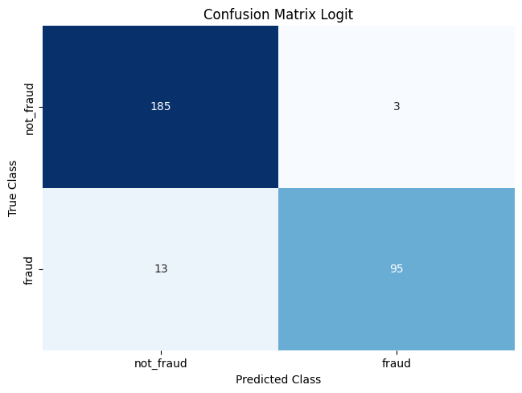
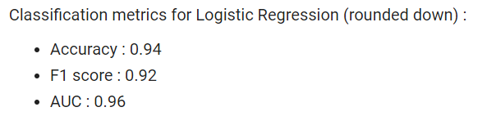
Result & Output
The results of algorithms that we have used to perform the credit card fraud detection are:
Logistic Regression: Visualize the Confusion matrix for Logistic regression algorithm.
The evaluation metrics of the Logistic Regression model will be as follows

Slide 11
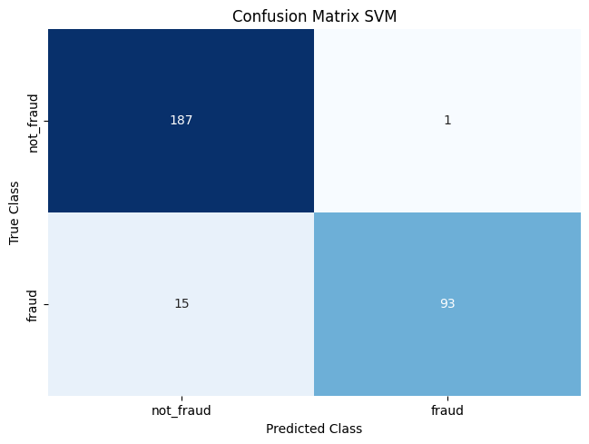
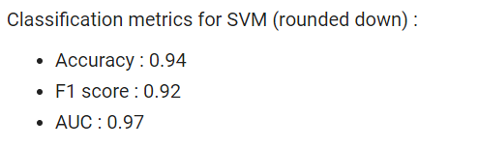
Result & Output
The results of algorithms that we have used to perform the credit card fraud detection are:
Support Vector Machine: Visualize the Confusion matrix for Support Vector Machine(SVM) algorithm
The evaluation metrics of the Support Vector Machine(SVM) will be as follows

Slide 12

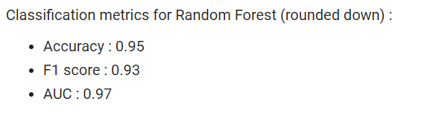
Result & Output
The results of algorithms that we have used to perform the credit card fraud detection are:
Random Forest(RF): Visualize the Confusion matrix for Random Forest algorithm
The evaluation metrics of the Random Forest model will be as follows

Slide 13
Conclusion
Fraud detection is an important process for businesses and consumers to protect themselves from financial loss.
Fraud detection systems use a variety of factors to identify suspicious transactions, including purchase amounts, locations, and device information.
Random forest is a powerful machine learning algorithm that can be used to develop fraud detection systems.
By detecting and preventing fraudulent transactions, businesses can protect their customers and their bottom line.

Slide 14
Future Scope
Future potential for credit card fraud detection is vast, with rapid progress driven by AI and ML.
AI and ML models analyze transaction sets to learn patterns and anomalies, enhancing accuracy in detecting fraudulent activity.
Integration with technologies like behavioral analytics and device fingerprinting is crucial for a holistic view of customer activity.
Behavioral analytics can identify sudden large purchases or unusual account access, improving fraud detection.
Fraud detection systems must evolve to work seamlessly across multiple channels (online, offline, mobile) to effectively combat fraud.

Slide 15
References
[1]F. A. Almarshad, G. A. Gashgari and A. I. A. Alzahrani, "Generative Adversarial Networks-Based Novel Approach for Fraud Detection for the European Cardholders 2013 Dataset," in IEEE Access, vol. 11, pp. 107348-107368,2023,doi: 10.1109/ACCESS.2023.3320072.
[2]V, Viswanatha and A.C, Ramachandra and V, Deeksha and R, Ranjitha, Online Fraud Detection Using Machine Learning Approach (August 7, 2023). International Journal of Engineering and Management Research | Volume-13, Issue-4 (August 2023), Available at SSRN: https://ssrn.com/abstract=4533856.
[3]Vaishnavi Nath Dornadula, S Geetha,Credit Card Fraud Detection using Machine Learning Algorithms,Procedia Computer Science,Volume 165,2019,Pages 631-641,ISSN1877-0509,https://doi.org/10.1016/j.procs.2020.01.057.
[4]Ryman-Tubb, Nick F., Paul Krause, and Wolfgang Garn. "How Artificial Intelligence and machine learning research impacts payment card fraud detection: A survey and industry benchmark." Engineering Applications of Artificial Intelligence 76 (2018): 130-157.
[5]Tiwari, P., Mehta, S., Sakhuja, N., Kumar, J., & Singh, A. K. (2021). Credit card fraud detection using machine learning: a study. arXiv preprint arXiv:2108.10005.

